Slide 1
Analysis on sales of used cars
Done by: Mentor: Anjaneyulu Sir
Ravi Teja
Madhav Mitesh Trivedi
Yugender
Aakash

Slide 2
Introduction
1:Dataset contains the sales of one of the used cars company.
2:It consists of approximately 10K records
3:The information on the sales of cars is collected from past few decades

Slide 3

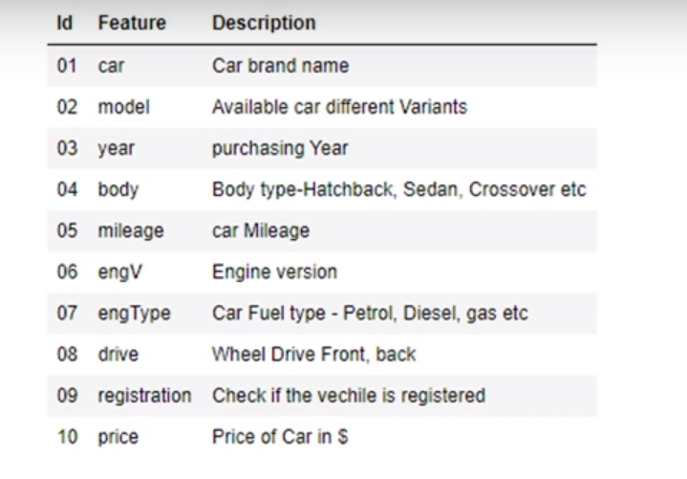
Introduction
The below table describes the data

Slide 4
Problem Statement
The companies have a good reputation in the market because of its sincerity and the quality of services. But from the past few months the sales have gone down.
1

Slide 5

Objective:
To find out the potential reason due to which the sales are not going well, despite of the company’s quality services provided to the customer.

Slide 6
Literature Review: •The used cars market is segmented the basis of on vehicle type, fuel type, distribution channel, and region. ~ On the basis of vehicle type, itis divided into hatchback, sedan, and SUV. ~On the basis of fuel type, it is classified into petrol, diesel, and others. ~On the basis of fuel type, it is classified into petrol, diesel, and others.

Slide 7
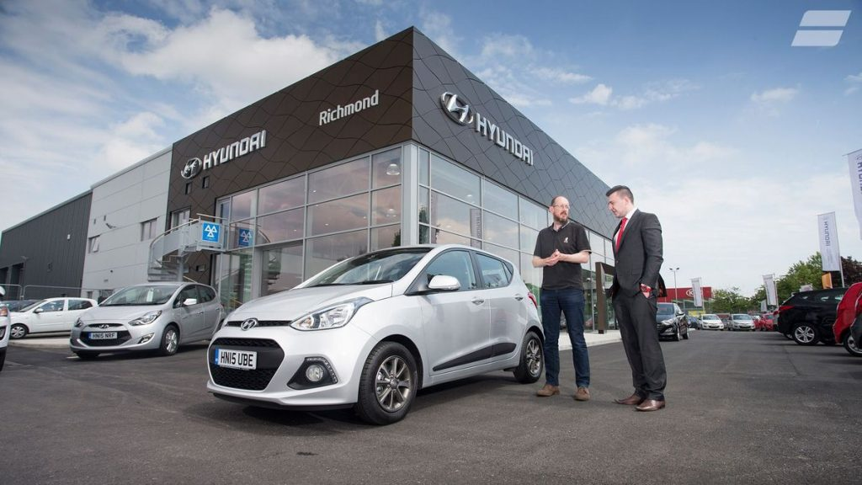
~ On the basis of distribution channel, it is fragmented into franchised dealer, independent dealer, and others.
~ On the basis of region, the market is analyzed across North America, Europe, Asia-Pacific, and LAMEA.
This Photo by Unknown Author is licensed under CC BY-SA-NC

Slide 8
We will be performing Exploratory Data Analysis on the data we have collected.
• You can check the data set and the Exploratory data analysis performed, by clicking the link below
Analysis-on-used-cars-sales-data/Analysis on Used Cars Data.ipynb at main · MADDY060620003/Analysis-on-used-cars-sales-data (github.com)

Slide 9
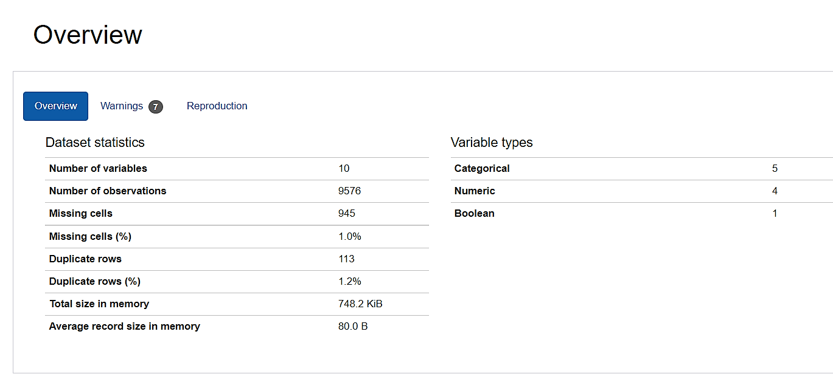
We have some duplicate and missing values in the data
Hence by pandas profiling we find the errors in the data and process it.

Slide 10
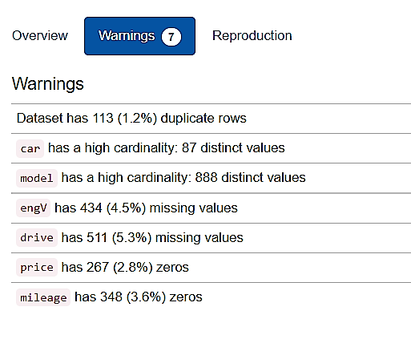
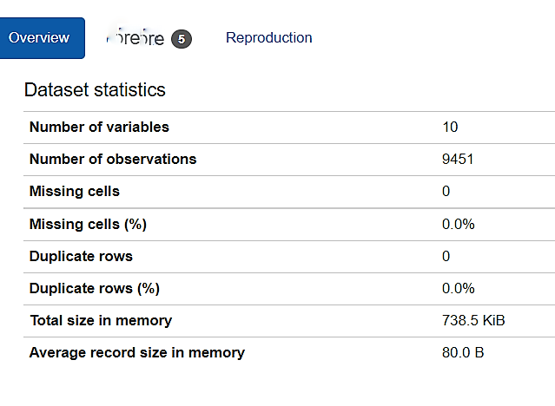
By pandas processing we clear the errors and the data is ready to explore
Before Processing After processing

Slide 11
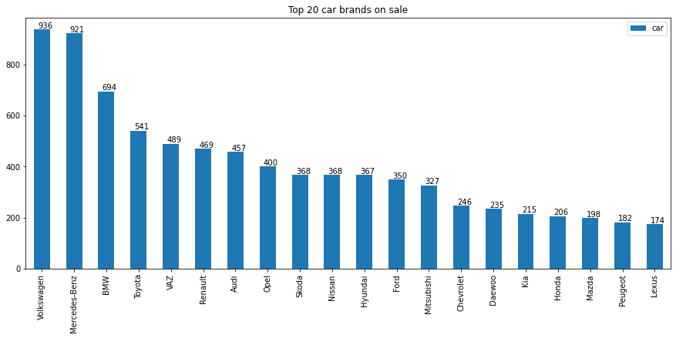
Data Exploration:
We here have a bargraph showing sales of top20 brands

Slide 12
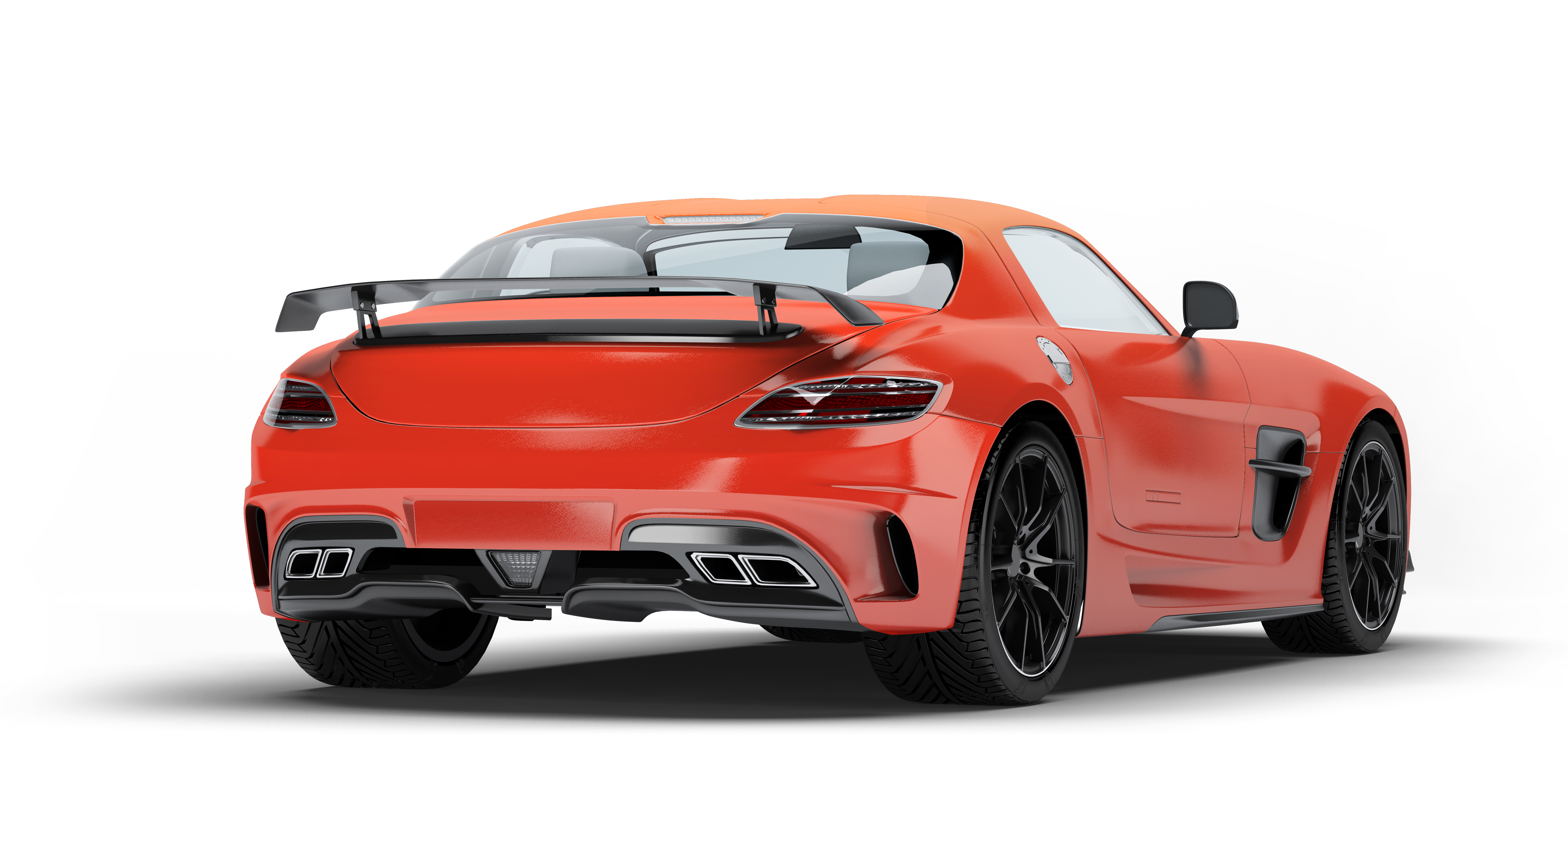

We can divide the cars in our data according to their class’s ~Premium Class ~Luxury Class ~Economy Class

Slide 13
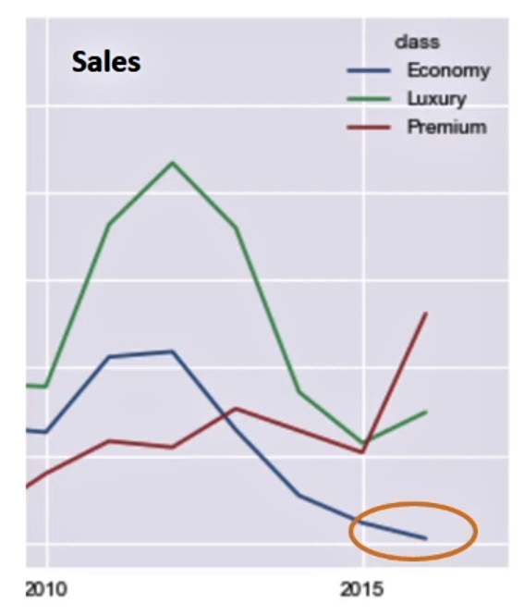
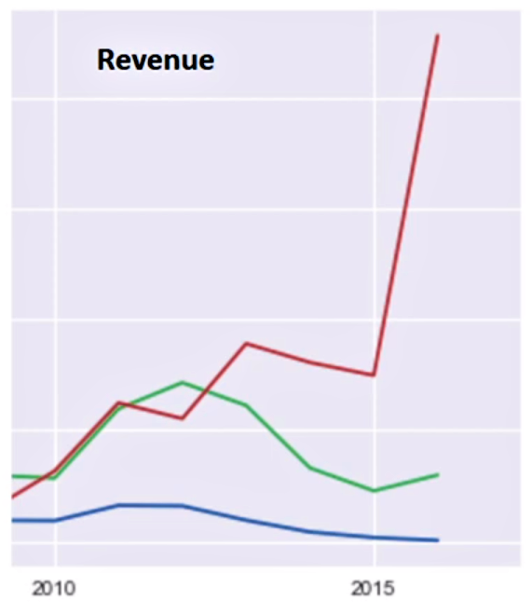
We now check the sales of the cars and revenue generated based on the class of the cars with the help of line charts.

Slide 14
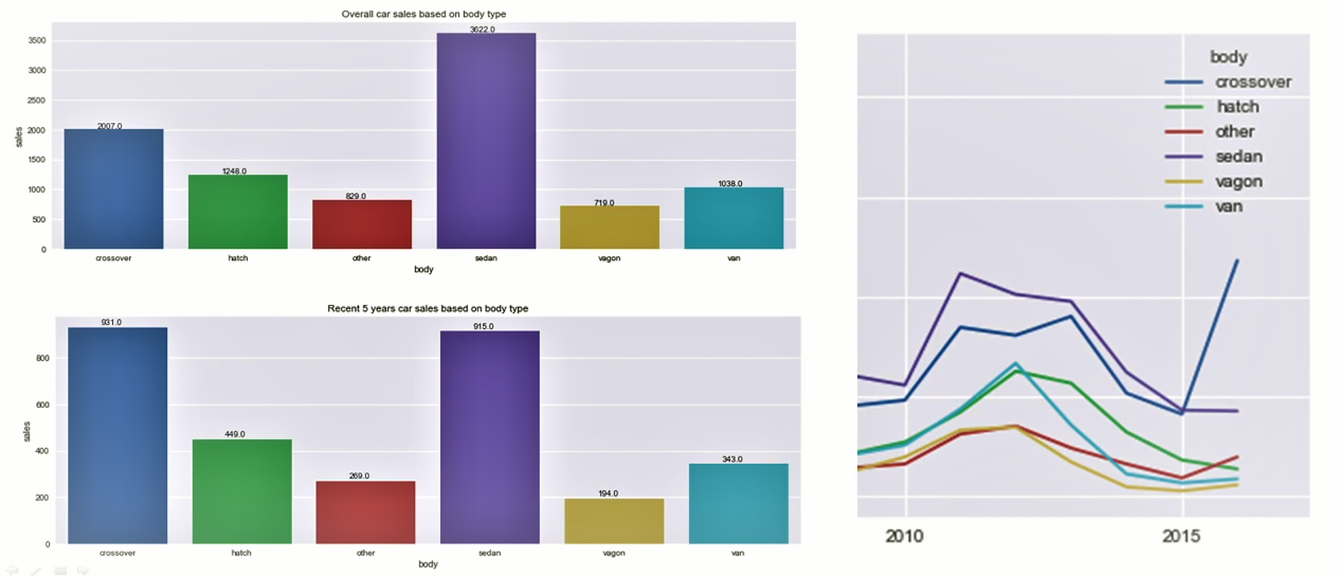
We now check the sales of the cars based on its body type.

Slide 15
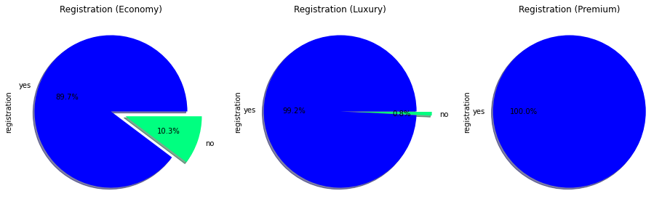
Checking the registration of the cars based on the class of the cars

Slide 16
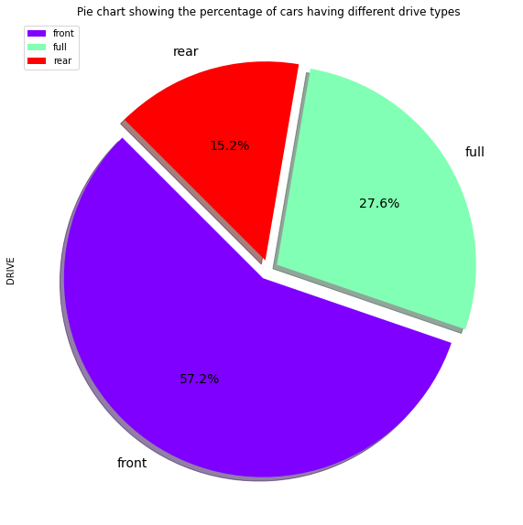
We now check the drive type in cars from the data

Slide 17
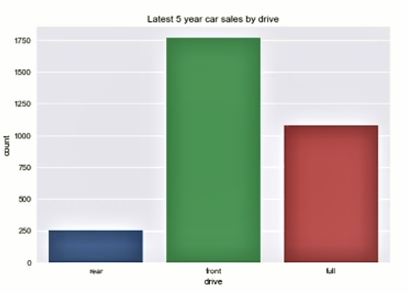
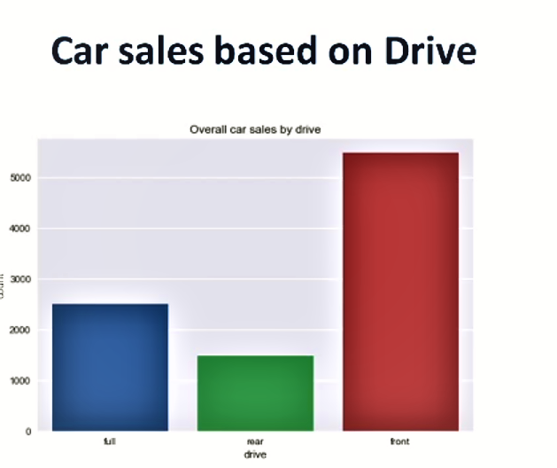
We now check the car sales based on its drive type: ~Front ~Rear ~Full

Slide 18

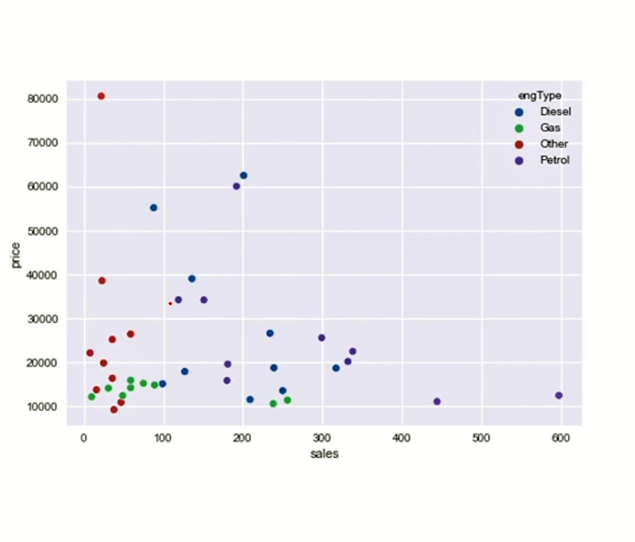
Correlation between sales and prices :
We check the correlation using plot chart

Slide 19

Observations and Conclusion
There are very few cars sold in 20,000 to 36,000 price bracket, which is the best price range
None of the cars sold from Economy segment in the year 2016
Cars registrations are most considered in Luxury and Premium class

Slide 20

Most sales are happened between 10,000 to 40,000/-
From the recent years the car sales are stagnated on the gas type
Petrol car sales are consistent
Diesel car sales are gaining momentum
Other car sales are increasing gradually

Slide 21
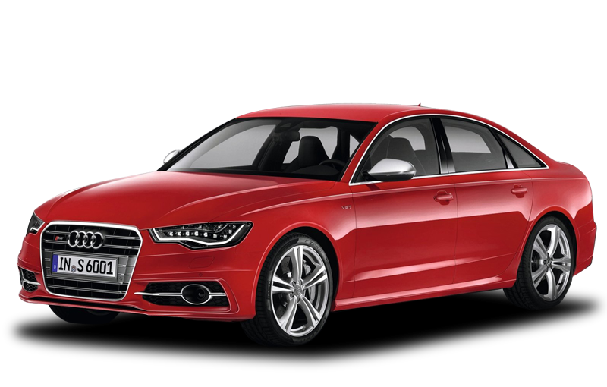
Most preferred cars are:
engine types are petrol and diesel
body types are cross-overs and sedan
Sedan are always on demand follows with Cross-over and hatch.
Most of the recent premium cars engine type is Petrol.

Slide 22
Actionable Insights
The cars should be available from all price ranges
The most sales are happening in the range of 10,000 to 40,000/- thus there are no cars available in 20,000 to 36,000/-price range
There should be more marketing for the latest and sophisticated cars engine types as in the Hybrid or Electric cars.

Slide 23
THANKS!
Any queries?
Reference: Github

